Slide 1
Lecture one
Introduction to Mechanics lab
Practical work in physics is intended to teach the student how to select and set up apparatus skillfully and well, to make careful observations and precise measurement while at time realizing the limitation of measuring instruments employed, and to use the experiment results obtained to the best advantage.

Slide 2
Lecture two
Experiment No (1) simple pendulum
Objectives:
1. To measure the acceleration due to gravity using a simple pendulum.
2. To investigate the relationship between the length of a pendulum and its oscillation period.
Procedure:
1. Measure the diameter of pendulum bob by using micrometer and record the radius of pendulum bob.
2. Measure the length of the pendulum from hanging point to the surface of the pendulum bob (l). Record the length of the pendulum in the table below.
3. Pull the bob from the equilibrium position. (This is the dotted line in the picture below and represents where the pendulum hangs when it is still).
4.With the help of a lab partner, set the pendulum in motion until it completes 10 to and fro oscillations, taking care to record this time. Then the period (𝑇) for one oscillation is just the number recorded divided by 10, then determine the (𝑇2).
5. You will make a total of five measurements for (g) using different values for the length (L).
6. Plot the relationship between the (𝑇 2) on Y-axis and the (L) on the X-axis, then find the slop of this line.

Slide 3
Lecture three
Experiment No (2)
Hooke's law
Objectives:
1. To verity Hooke's law.
2. To determine the force constant of the spring (K).
Procedure:
1. Measure the position of the spring. This is your equilibrium position.
2. Add the (50 g) mass pan from the spring and measure the position of the mass pan.
3. Add (100 g) masses to the pan and measure resulting positions of the system, until you have a five 100 g masses on the mass pan.
4.Then remove the masses in reverse order, one at a time, again noting the corresponding displacement. This will effectively give you two trials, which can be averaged; you may wish to comment on any trends or differences you see between the trials).
5. Graph and analyze of your data

Slide 4
Lecture four
Experiment No (3)
Archimedes’ principle
Objectives:
1. To verity Hooke's law.
2. To determine the force constant of the spring (K).
Procedure:
1. Measure the position of the spring. This is your equilibrium position.
2. Add the (50 g) mass pan from the spring and measure the position of the mass pan.
3. Add (100 g) masses to the pan and measure resulting positions of the system, until you have a five 100 g masses on the mass pan.
4.Then remove the masses in reverse order, one at a time, again noting the corresponding displacement. This will effectively give you two trials, which can be averaged; you may wish to comment on any trends or differences you see between the trials).
5. Graph and analyze of your data

Slide 5
Lecture five
Experiment No (4) flywheel
Objective:
The purpose of this experiment is to determine the moment of inertia for flywheel.
Procedure:
1. Attach one end of the thread to load the weights and wrap the other end around the axis of the wheel and the length of the thread must be approximately equal to the distance between the axis and the surface of the earth.
2. Measure the height (ℎ) of the weight from the floor.
3. Let the weight falling and the weight reaches the floor and the thread detaches itself from the axel.
4. Measure the number of revolution (𝑛) for the flywheel before the weight reaches the floor.
5. Measure the number of revolution (𝑁) for the flywheel after the weight has reached the floor and before the flywheel stop.
6. Measure the time (𝑡) taken to reach the weight to the floor.
7. Repeat these steps for the same weight and calculate the (𝑛𝑎𝑣𝑒.,𝑁𝑎𝑣𝑒 and 𝑡𝑎𝑣𝑒.).
8. Measure the radius of the flywheel axis (𝑟) by using the Vernier.
9. Using equation (6) to calculate the amount of inertia.
10. Change the weight and repeat all steps (2→9).

Slide 6
Lecture six
Experiment No (5)
Maxwell’s wheel
Objective:
To measure the transformation of potential energy into translational and rotational energy .
Procedure:
1. Move the wheel to its highest position where the ruler reading is 0.
2. Release the wheel and start the stopwatch until it passes the specified height and stop the stopwatch.
3. Note down the time (𝒕).
4. Repeat (1).
5. Release the wheel but start the stopwatch only at the specific point and stop it.
6. Note the time (𝒕′).
7. Use the following table. Note that (𝒅=𝟏∗𝟏𝟎−𝟐 𝒎) which is the diameter of the spindle:
8.After finding the velocity and the inertia, it is easy to measure the transformed energy by using the following table:

Slide 7
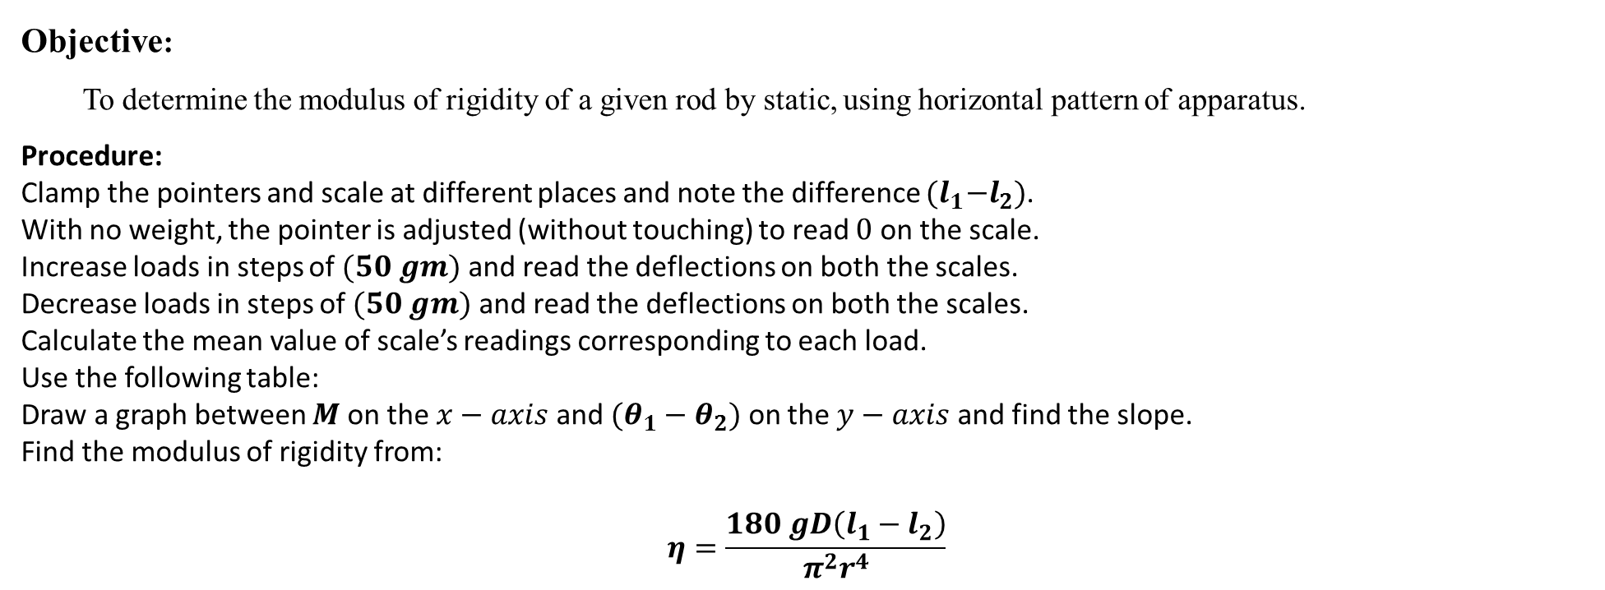
Lecture seven
Experiment No (6)
Modulus of Rigidity (Torsion)
Objective:
To determine the modulus of rigidity of a given rod by static, using horizontal pattern of apparatus.
Procedure:
Clamp the pointers and scale at different places and note the difference ${(l}_{1}−l_{2})$.
With no weight, the pointer is adjusted (without touching) to read $0$ on the scale.
Increase loads in steps of $(50 gm)$ and read the deflections on both the scales.
Decrease loads in steps of $(50 gm)$ and read the deflections on both the scales.
Calculate the mean value of scale’s readings corresponding to each load.
Use the following table:
Draw a graph between $M$ on the $x−axis$ and $(θ_{1}−θ_{2})$ on the $y−axis$ and find the slope.
Find the modulus of rigidity from:
$$η=\frac{180 gD\left(l_{1}−l_{2}\right)}{π^{2}r^{4}}$$

